Slide 1

FULL STACK DEVELOPMENT
A small introduction

Slide 2

WHAT IS FULL STACK?
Full Stack Development refers to the development of both front end(client side) and back end(server side) portions of web application

Slide 3
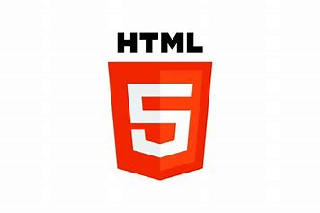
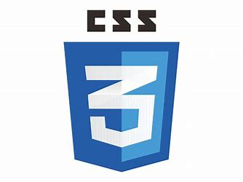
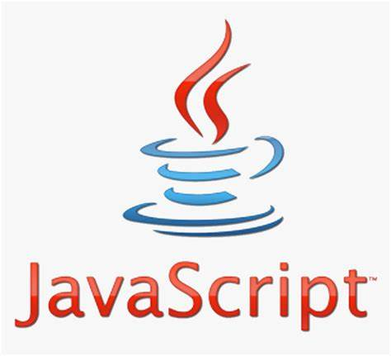
FRONT END
Front-end development involves creating the UI and UX components of a website or application.
HTML
CSS
JAVA SCRIPT

Slide 4
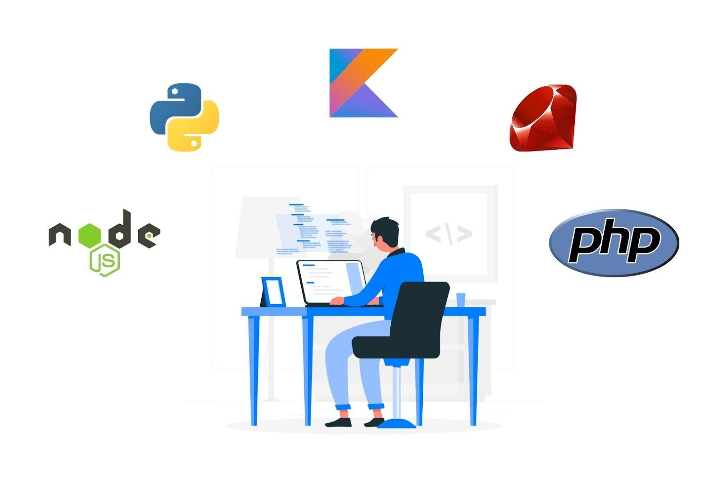
BACK END
Back-end development means working on server-side software, which focuses on everything you can’t see on a website like the application's logical part, managing databases, and servers.

Slide 5
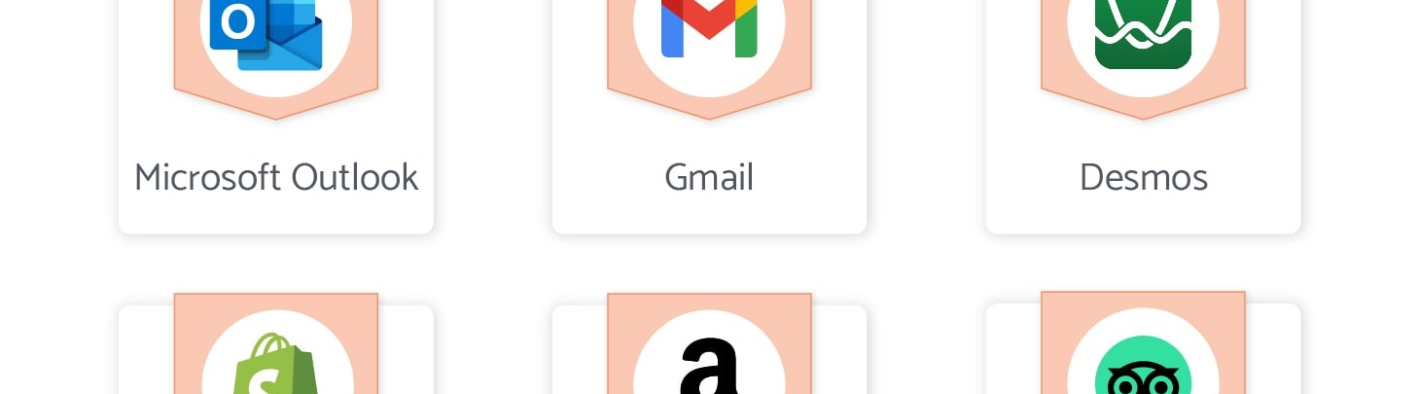
APPLICATION
WEB APPLICATION
STAND ALONE APPLICATION
A Web App is like a special computer program that you can use on the internet without having to download it onto your computer.
A standalone application, also known as a desktop application is a software program designed in such a way that to run this software program, users don’t need an internet connection or any server access.
5

Slide 6
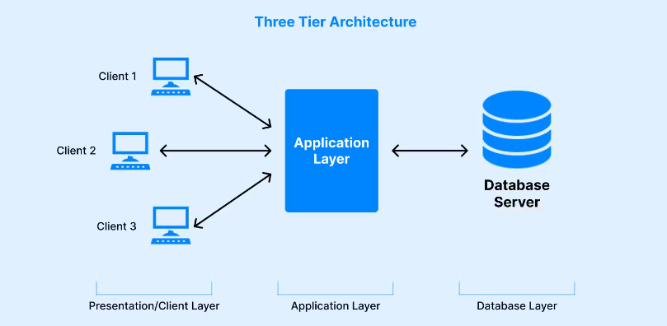
3 TIER ARCHITECTURE
PRESENTATION LAYER -The presentation tier is the user interface and communication layer of the application
APPLICATION LAYER -as the information/request gathered through the presentation tier is processed in detail here
DATABASE LAYER – it is responsible for managing and storing data.

Slide 7
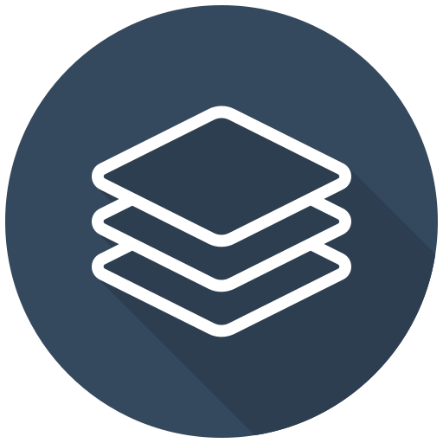


ARCHITECTURE
PRESENTATION
LAYER
DATA BASE
LAYER
APPLICATION
LAYER

Slide 8
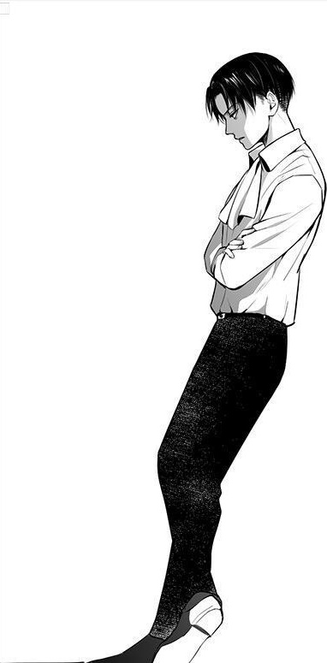


THANK YOU!
D.HARTHIK
harthikdurishetti@gmail.com

